Slide 1

Emergency Department Use in Brooklyn
by Neighborhood
Michael Birnbaum
Vice President
United Hospital Fund
September 21, 2011

Slide 2
Study Parameters, Definitions, and Data Sources
Population
  All Brooklyn residents
Definition of emergency department (ED) visit
  “Treat and release” visits (not resulting in admissions)
Volume and types of ED visits and admissions
  Source: Statewide Planning and Research Cooperative System (SPARCS) data up-weighted to reflect Institutional Cost Report (ICR) data
Patient characteristics
  Source: SPARCS data
Neighborhood populations
  Source: New York City Department of Health and Mental Hygiene Neighborhood Population Estimates

Slide 3
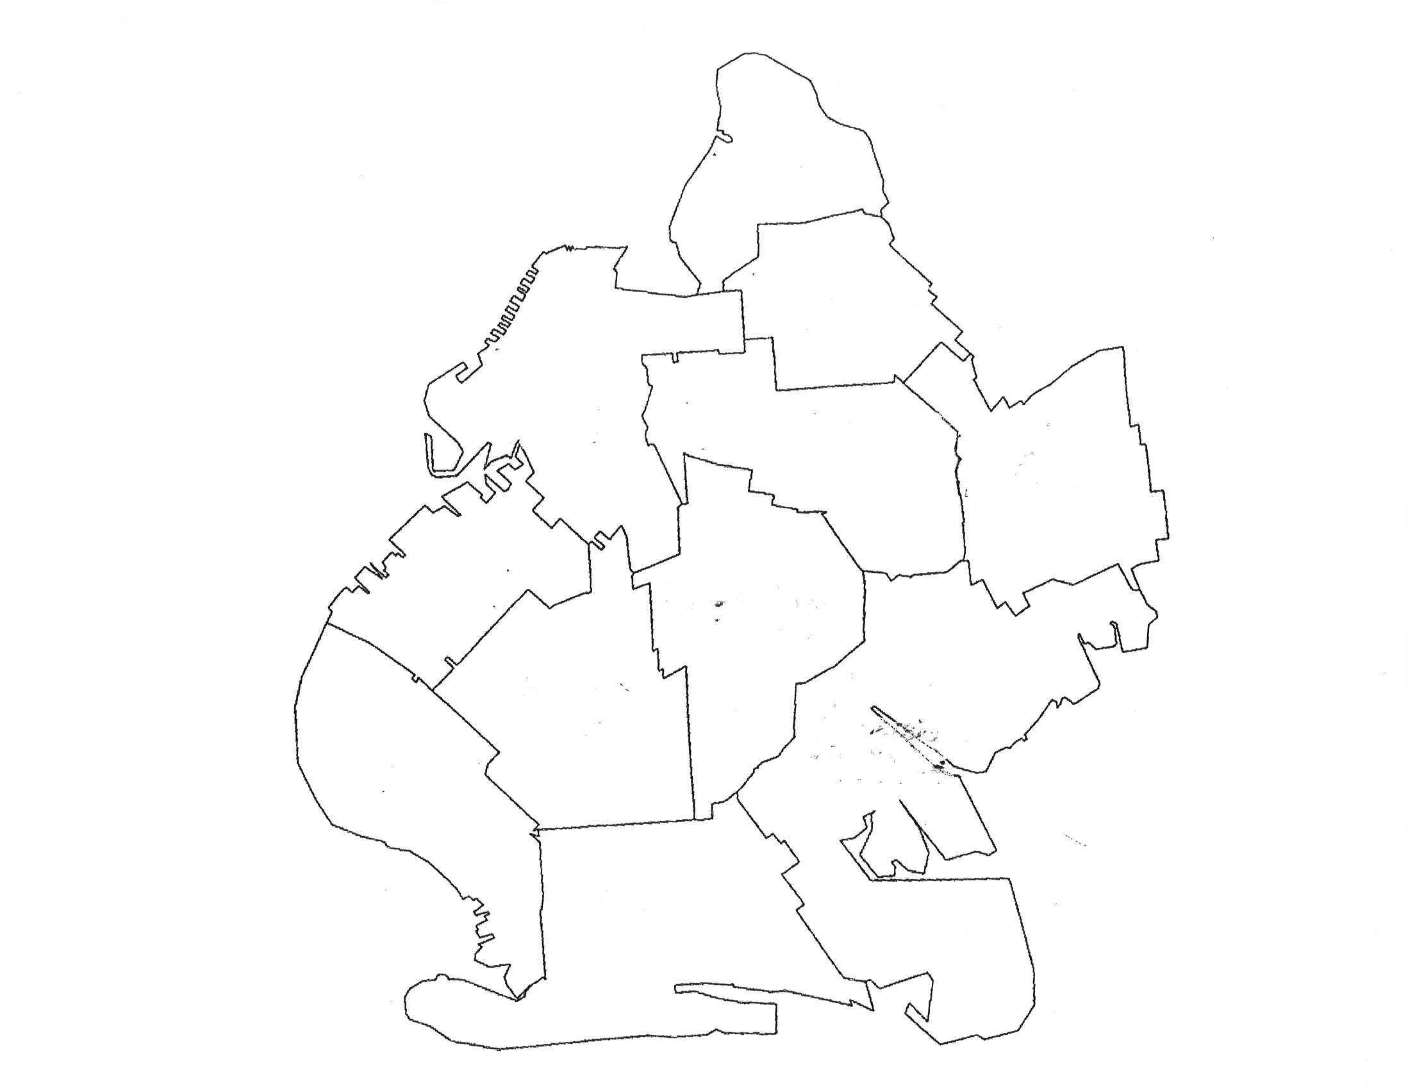
Map of United Hospital Fund Brooklyn Neighborhoods
Greenpoint
Bushwick and Williamsburg
Northwest Brooklyn
Central Brooklyn
East New York and New Lots
Sunset Park
Flatbush
Canarsie and Flatlands
Borough Park
Southwest Brooklyn
Southern Brooklyn

Slide 4
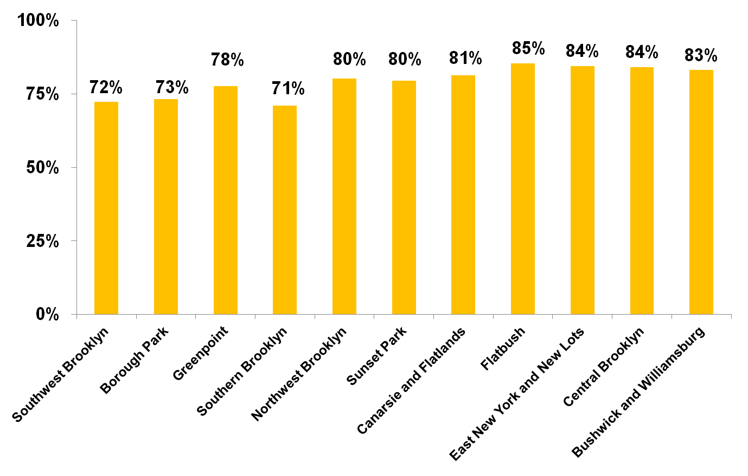
Share of ED Visits Not Resulting in Hospital Admissions (2008)
NYC Average
81%
Source: United Hospital Fund analysis of SPARCS data and Institutional Cost Reports.

Slide 5
ED Use Among Brooklyn Residents by Neighborhood
ED Visits per 100 Residents
Hospital Admissions per 100 Residents
Share of Residents with at Least One ED Visit
Share of Residents with Three or More ED Visits
Share of ED Visits by Frequency of ED Use

Slide 6
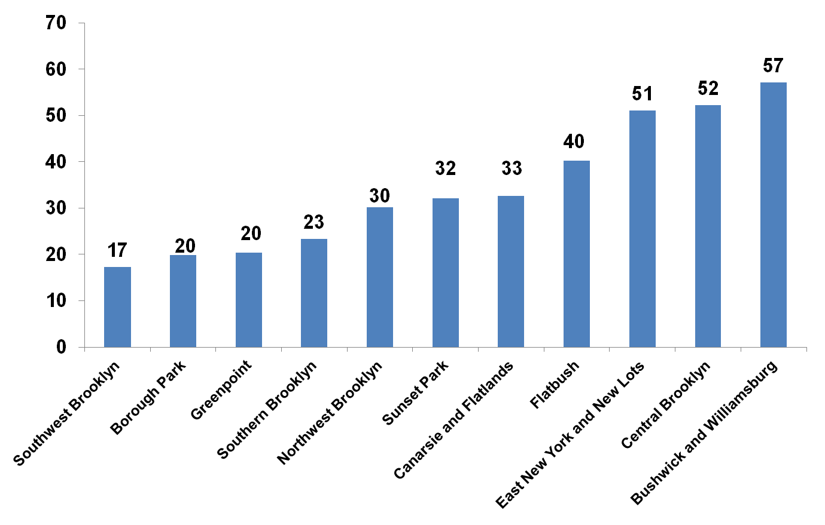
ED Visits per 100 Residents (2008)
NYC Average
36
Source: United Hospital Fund analysis of SPARCS data, Institutional Cost Reports, and NYC DOHMH Neighborhood Population Estimates.
Note: Rates are age- and sex-adjusted.

Slide 7
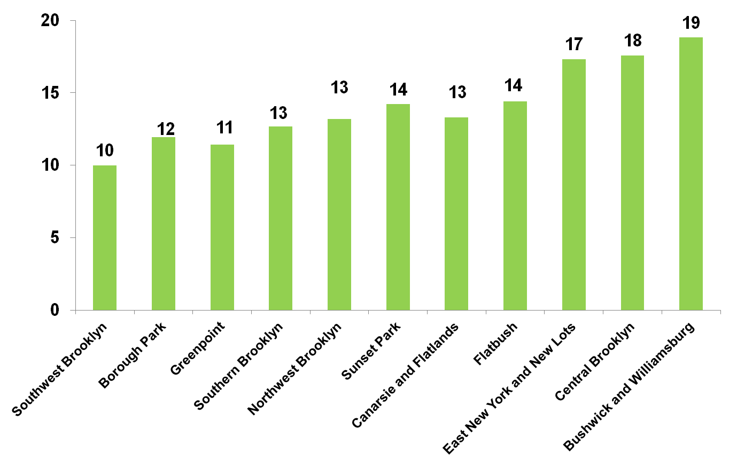
Hospital Admissions per 100 Residents (2008)
NYC Average
14
Source: United Hospital Fund analysis of SPARCS data, Institutional Cost Reports, and NYC DOHMH Neighborhood Population Estimates.
Note: Rates are age- and sex-adjusted.

Slide 8
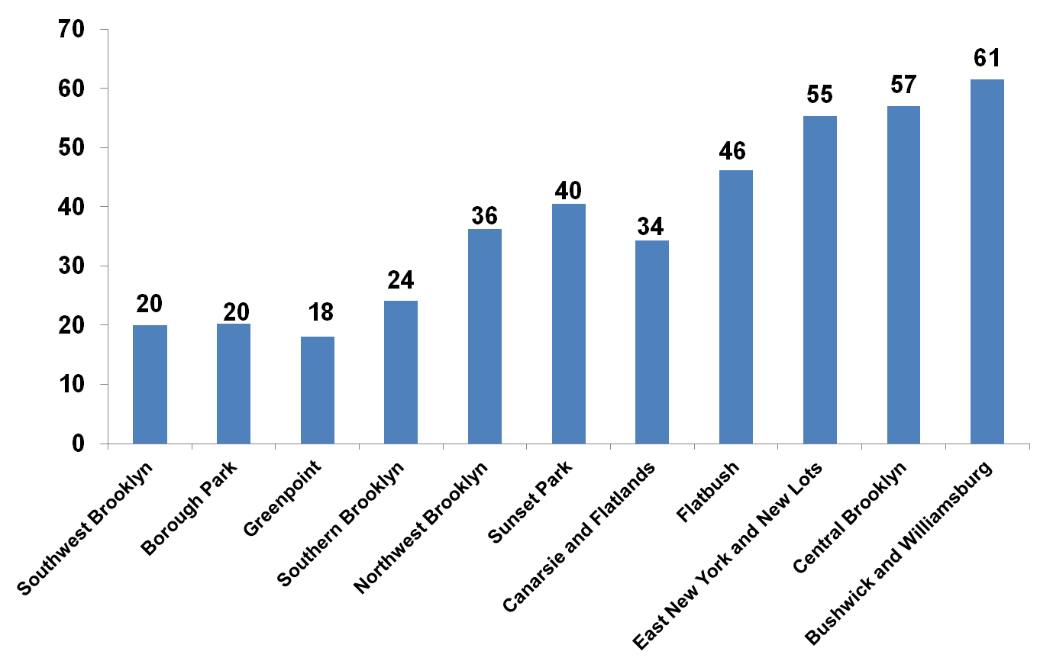
ED Visits per 100 Children (2008)
NYC Average
46
Source: United Hospital Fund analysis of SPARCS data, Institutional Cost Reports, and NYC DOHMH Neighborhood Population Estimates.

Slide 9
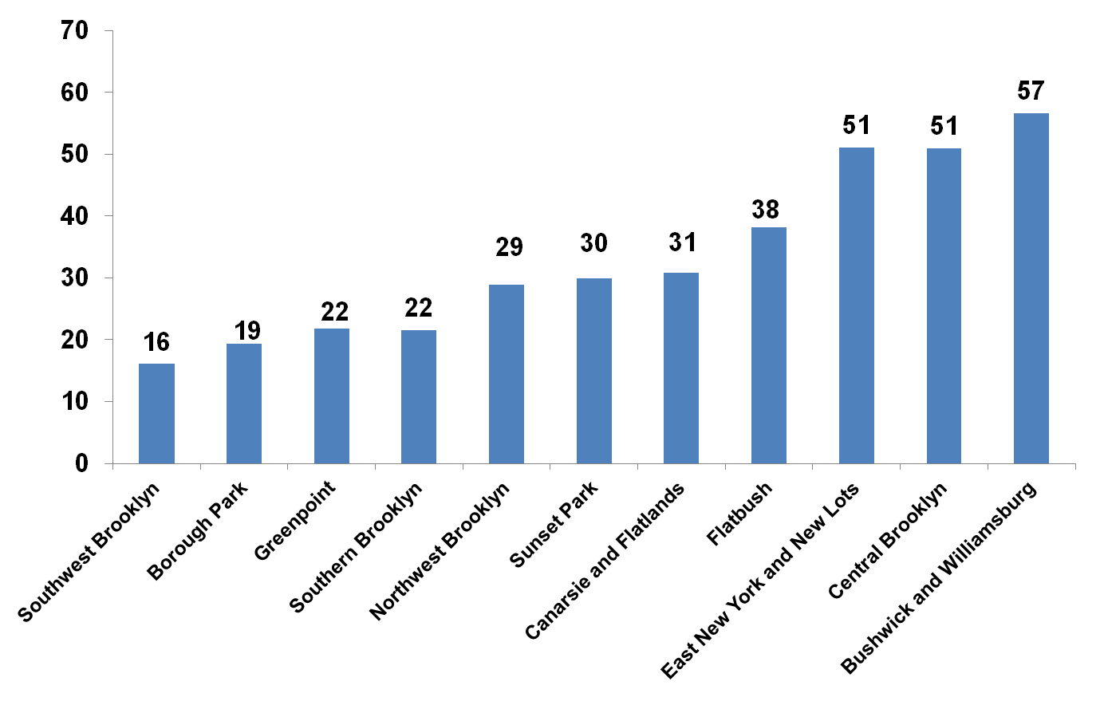
ED Visits per 100 Adults (2008)
NYC Average
33
Source: United Hospital Fund analysis of SPARCS data, Institutional Cost Reports, and NYC DOHMH Neighborhood Population Estimates.

Slide 10
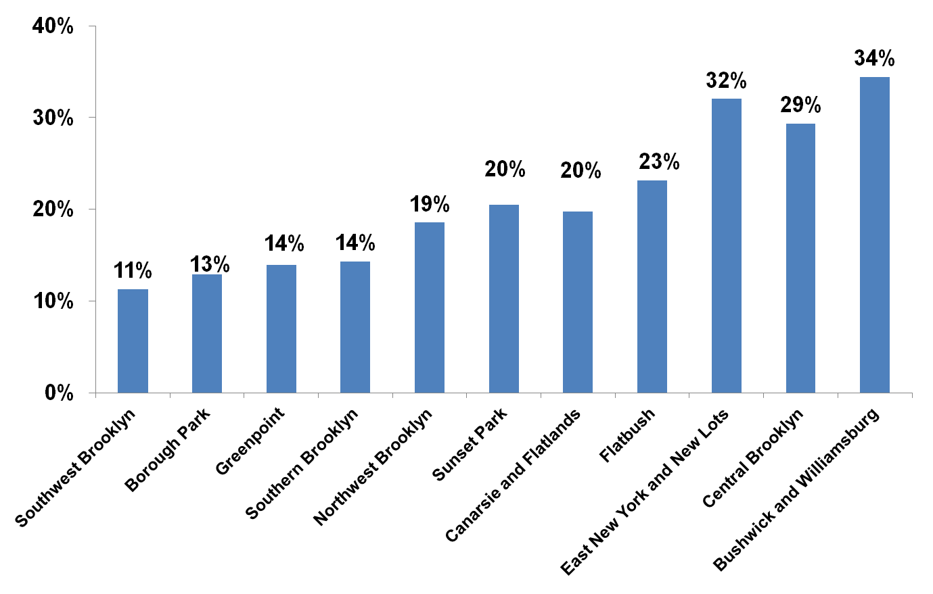
Share of Residents with at Least One ED Visit (2008)
NYC Average
22%
Source: United Hospital Fund analysis of SPARCS data and NYC DOHMH Neighborhood Population Estimates.

Slide 11
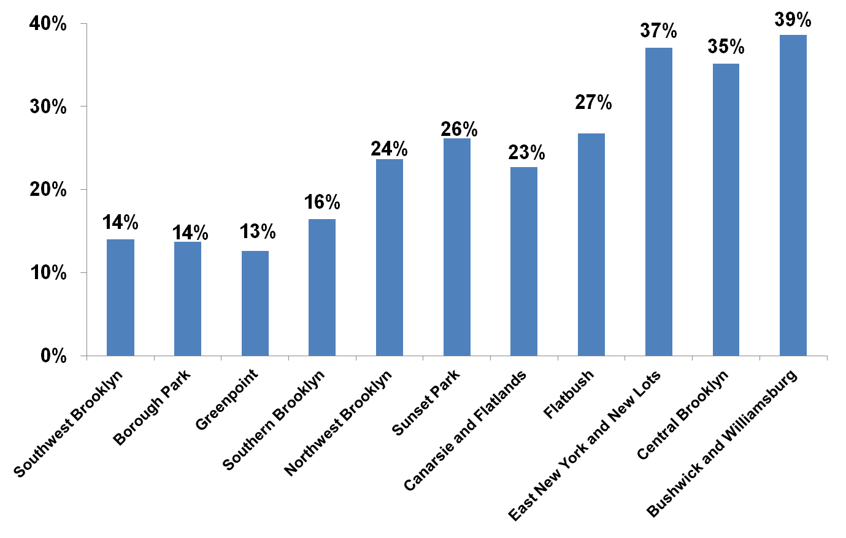
Share of Children with One or More ED Visits (2008)
NYC Average
29%
Source: United Hospital Fund analysis of SPARCS data and NYC DOHMH Neighborhood Population Estimates.

Slide 12
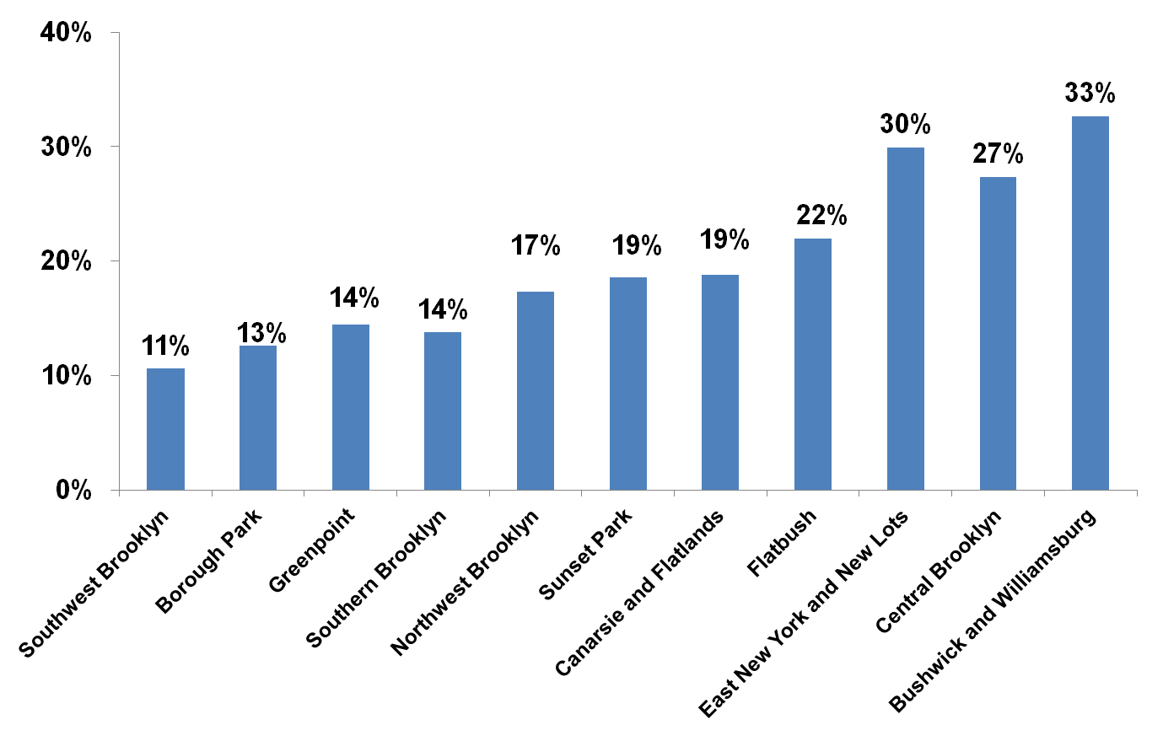
Share of Adults with One or More ED Visits (2008)
NYC Average
20%
Source: United Hospital Fund analysis of SPARCS data and NYC DOHMH Neighborhood Population Estimates.

Slide 13
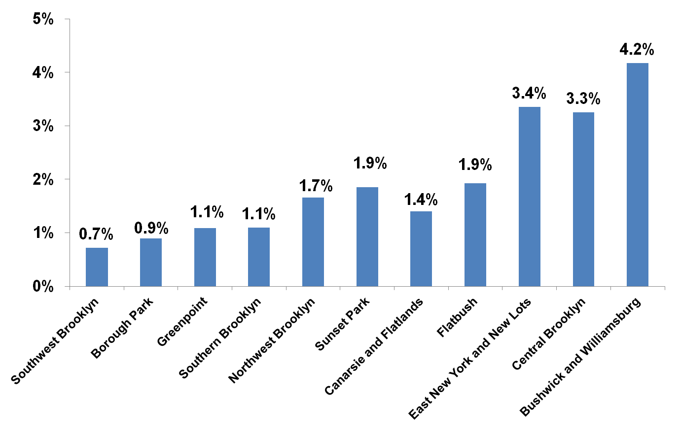
Share of Residents with Three or More ED Visits (2008)
NYC Average
2.1%
Source: United Hospital Fund analysis of SPARCS data and NYC DOHMH Neighborhood Population Estimates.

Slide 14
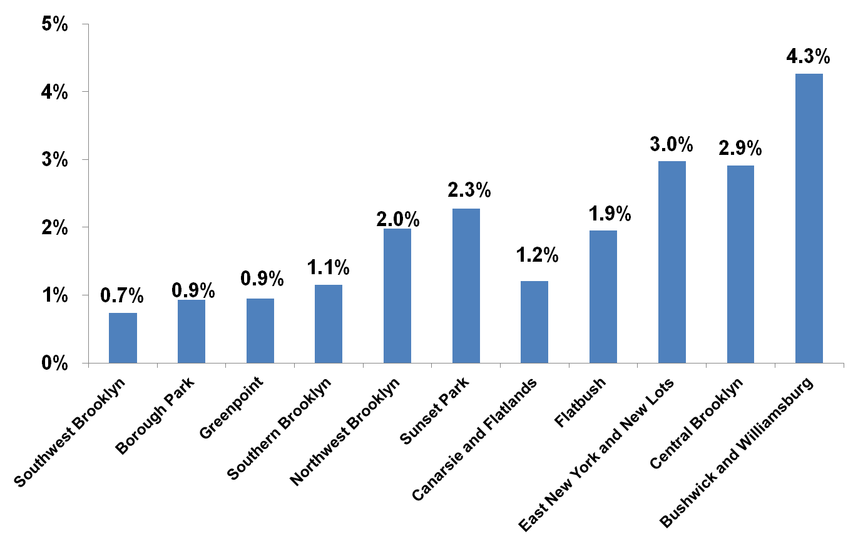
Share of Children with Three or More ED Visits (2008)
NYC Average
2.7%
Source: United Hospital Fund analysis of SPARCS data and NYC DOHMH Neighborhood Population Estimates.

Slide 15
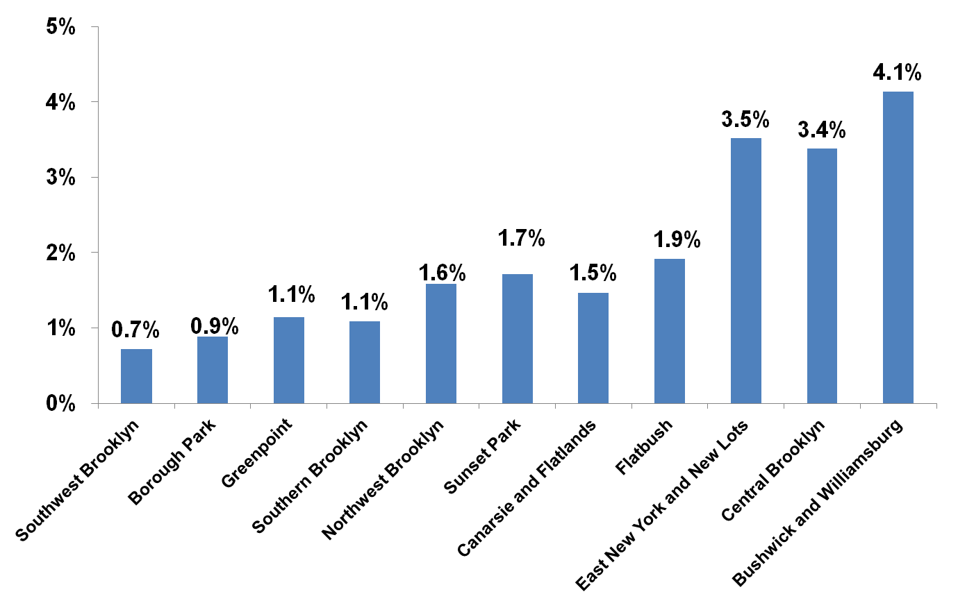
Share of Adults with Three or More ED Visits (2008)
NYC Average
1.9%
Source: United Hospital Fund analysis of SPARCS data and NYC DOHMH Neighborhood Population Estimates.

Slide 16
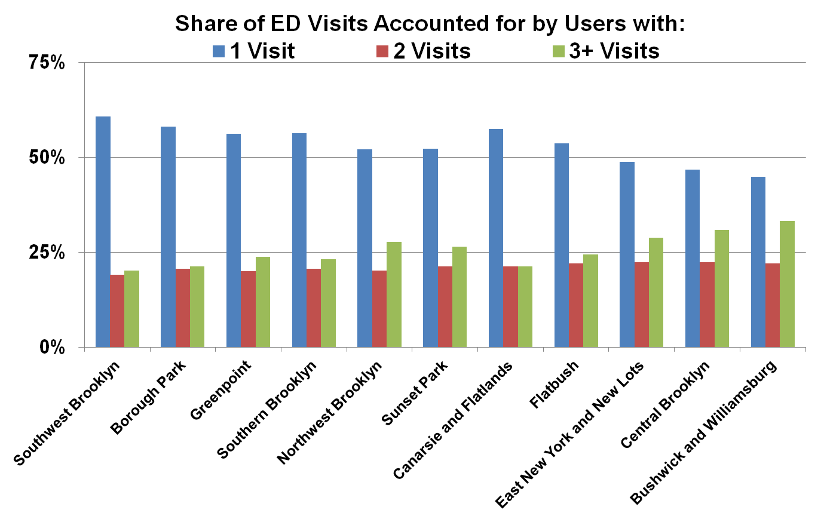
Share of ED Visits by Frequency of ED Use (2008)
Source: United Hospital Fund analysis of SPARCS data.

Slide 17
Findings
Residents in certain Brooklyn neighborhoods have much higher rates of ED use than those in others.
Variation in ED use among neighborhoods is greater than variation in hospital admissions.
Children are more likely than adults to use the ED.
Variation in ED use among neighborhoods is greatest for residents with 3 or more visits.

